Slide 1
LOGO

Slide 2
2nd page- enter Patient’s name, age/sex and date
3rd- Mixed dentition/ permanent dentition
Cast/ cephalometric analysis
Last page- View all results, in the bottom- save as file. Do you want to share it? Mail, what’sapp

Slide 3
While it must not be supposed that variations from normal occlusion can be measured accurately and that orthodontic diagnosis can be based upon mathematical calculations, nevertheless, the ability to predetermine arch size, within limits is a useful diagnostic aid.
……John Stifter, B.S., D.D.S. A Study Of Pont's, Howes', Rees', Neff's And Bolton's Analyses On Class I Adult Dentitions. Angle Orthod (1958) 28 (4): 215–225.
Normal occlusion: Occlusion of the teeth is normal when their manifold functions are efficiently performed and the health of the supporting structures is maintained. The primary functions of the teeth include mastication, esthetics, and the functions of speech and deglutition.
………….Hemley, Samual. Orthodontic Theory and Practice, Gruno and Shatton: 549-551, 1953.

Slide 4
NEW
Cast analysis
Mixed dentition
Permanent dentition
Space calculation for space maintainer in buccal segment
Maxillary right |  |  | Maxillary left
E space | D space | C space | C space | D space | E space
2nd PM | 1st PM | Perm Canine | Perm Canine | 1st PM | 2nd PM
Mandibular right |  |  | Mandibular left
E space | D space | C space | C space | D space | E space
2nd PM | 1st PM | Perm Canine | Perm Canine | 1st PM | 2nd PM
Please Enter following space available values-
mesio-distal space/ dimension of C (C space)
Maxillary right Maxillary left
Mandibular right Mandibular left
2. mesio-distal space/ dimension of D (D space)
Maxillary right Maxillary left
Mandibular right Mandibular left
3. mesio-distal space/ dimension of E (E space)
Maxillary right Maxillary left
Mandibular right Mandibular left
ANALYSE
RESULT PAGE

Slide 5
INSTRUCTIONS
Fill in the values in millimeters only.
Huckaba’s analysis needs apparent width of teeth from IOPA X rays.
Cephalometric mixed dentition analyses and Bolton anterior ratio use width of the unerupted teeth according to Huckaba’s method.
Vernier caliper is preferable for measurements on cast or radiographs.

Slide 6
MEASUREMENTS FOR SPACE REQUIRED
ENTER THE ASKED VALUES IN MILLIMETERS ONLY
YOU CAN SKIP APPARENT VALUES, IF YOU DO NOT WANT
-HUCKABA ANALYSIS
-TOTAL SPACE ANALYSIS ( CEPHALOMETRIC)
- BOLTON ANTERIOR RATIO

Slide 7
S8 1
SPACE REQUIRED IN MAXILLARY ARCH
maximum mesio-distal width of each tooth in millimeter, preferably with digital Vernier calliper
RIGHT
Permanent central incisor
, 11
Permanent lateral incisor
, 12
Primary canine
, 53
Primary first molar
, 54
Primary second molar
, 55
Permanent first molar
, 16
LEFT
Permanent central incisor
21,
Permanent lateral incisor
22,
Primary canine
63,
Primary first molar
64,
Primary second molar
65,
Permanent first molar
26,
1
1
2
2
C
C
D
D
E
Maxillary teeth
E
6
6

Slide 8
S8 2
SPACE REQUIRED IN MANDIBULAR ARCH
maximum mesio-distal width of each tooth, preferably with digital Vernier calliper
RIGHT
Permanent first molar
,46
Primary second molar
,85
Primary first molar
,84
Primary canine
,83
Permanent lateral incisor
,42
Permanent central incisor
,41
LEFT
Permanent first molar
36,
Primary second molar
75,
Primary first molar
74,
Primary canine
73,
Permanent lateral incisor
32,
Permanent central incisor
31,
Mandibular teeth
6
6
E
E
D
D
C
C
2
2
1
1

Slide 9
S23
Radiographic (apparent) measurement for Huckaba’s method
Tooth | Maxillary |  | Mandibular
Permanent Canine | Left Right |  | Left |  | Right
1stPremolar | Left Right |  | Left |  | Right
2ndPremolar | Left Right |  | Left |  | Right
Primary 2ndmolar | Left Right |  | Left |  | Right
Permanent 1stmolar (for Total space analysis) | Left Right |  | Left |  | Right
Permanent 2ndmolar (for Total space analysis) | Mandibular only | Left |  | Right
Permanent 3rdmolar (Wheeler’s value for if not visible in radiographs- 10mm) (for Total space analysis) | Mandibular only | Left |  | Right

Slide 10
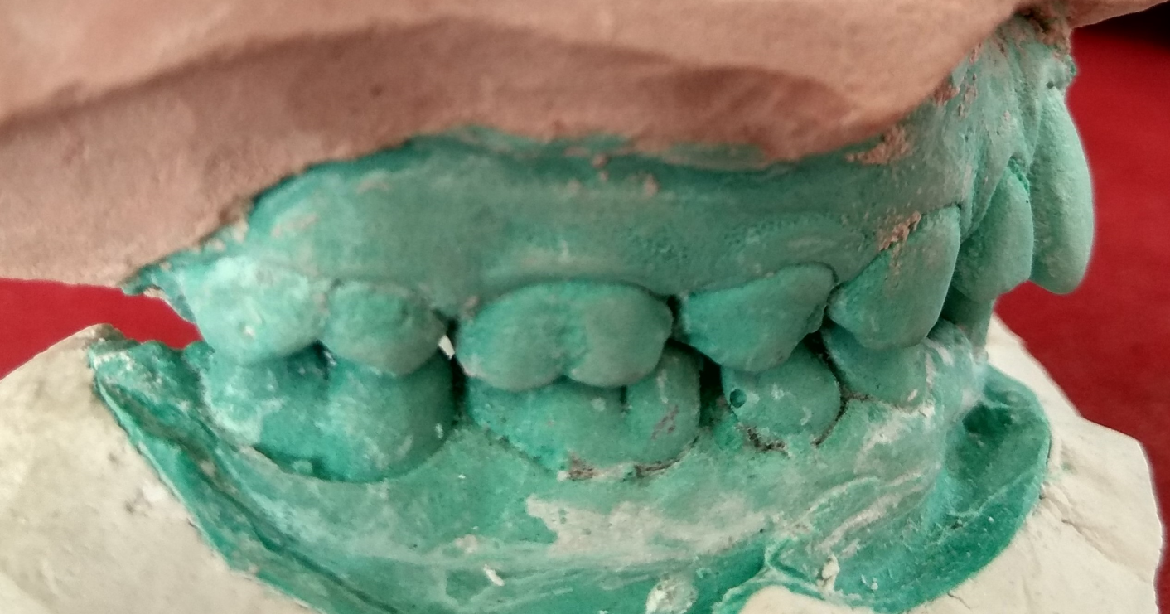
S8 3
SPACE REQUIRED IN MANDIBULAR ARCH
For late mesial shift OR to move mandibular 1st permanent molar into class I relation
IN FLUSH TERMINAL PLANE (END ON 6/6) ONLY
distance between cusp tip of mesio-buccal cusp of maxillary permanent first molar to bucco- developemental groove of mandibular first permanent molar
ENTER

Slide 11
MEASUREMENTS FOR SPACE AVAILABLE
ENTER THE ASKED VALUES IN MILLIMETERS ONLY

Slide 12
S29 1
Maxillary arch
Space available
From mesial surface of the permanent 1st molar to the mesial surface of the opposite permanent 1st molar along the buccal cusps of posterior teeth and incisal edges of anterior teeth on the basal bone

Slide 13
S29 2
Mandibular arch
Space available
From mesial surface of the permanent 1st molar to the mesial surface of the opposite permanent 1st molar along the buccal cusps of posterior
teeth and incisal edges of anterior teeth on the basal bone

Slide 14
S29 1
Maxillary arch
Tooth-size arch length discrepancy (TSALD)
Using
(any one of the mixed dentition analysis)
Analyse

Slide 15
S29 1
Mandibular arch
Tooth-size arch length discrepancy (TSALD)
Using
(any one of the mixed dentition analysis)
Analyse

Slide 16
S25, 26, 27, 28 will change to S25-2
Predicted combined width of permanent Cuspid and Bicuspids
According to- | Maxilla One side (right/ left) |  |  |  |  |  | Mandible One side (right/ left)
Moyer’s (--%, Male/female)
Tanaka & Johnston
Huckaba’s | Right |  |  | Left |  |  | Right |  |  | Left
 | C | D | E | C | D | E | C | D | E | C | D | E
 | 3 | 4 | 5 | 3 | 4 | 5 | 3 | 4 | 5 | 3 | 4 | 5
Fauda’s
Bachmann’s
Trankmann’s
Regional equations (India)
Tooth space arch length discrepancy (TSALD)
Maxilla | Mandible
RESULT PAGE 2

Slide 17
S32-1
Maxillary spaces available
Buccal segment &
Incisor space
ENTER
Available space
Incisor region
Incisor space available
Between midline to mesial point of primary canine/ distal point of permanent lateral incisor, whichever is nearer to midline (including interdental spaces and primate spaces if any)
right
left
RIGHT
LEFT
Buccal segment
available space
Between the lateral of permanent lateral incisor/ mesial of primary canine to mesial of the permanent first molar
Buccal segment
available space
Between the lateral of permanent lateral incisor/ mesial of primary canine to mesial of the permanent first molar
Buccal segment space available
right
left

Slide 18
S32-3
Mandibular spaces available
Buccal segment &
Incisor space
ENTER
Incisor space available
RIGHT
LEFT
available space
Between the lateral of permanent lateral incisor/ mesial of primary canine to mesial of the permanent first molar including primate space if any
available space
Between the lateral of permanent lateral incisor/ mesial of primary canine to mesial of the permanent first molar including primate space if any
Buccal segment space available
right
left
right
left
Available space
Incisor region
Between midline to mesial point of primary canine/ distal point of permanent lateral incisor, whichever is nearer to midline (including interdental spaces if any)

Slide 19
S13-1
SPACE REQUIRED IN MAXILLARY ARCH
maximum mesio-distal width of each tooth in millimetres, preferably with digital Vernier calliper
RIGHT
Permanent central incisor, 11
Permanent lateral incisor, 12
Permanent canine, 13
First premolar, 14
Second premolar, 15
Permanent first molar, 16
LEFT
Permanent central incisor, 21
Permanent lateral incisor, 22
Permanent canine, 23
First premolar, 24
Second premolar, 25
Permanent first molar, 26

Slide 20
S13-2
SPACE REQUIRED IN MANDIBULAR ARCH
maximum mesio-distal width of each tooth in millimetres, preferably with digital Vernier calliper
RIGHT
Permanent first molar, 46
Second premolar, 45
First premolar, 44
Permanent canine, 43
Permanent lateral incisor, 42
Permanent central incisor, 41
LEFT
Permanent first molar, 36
Second premolar, 35
First premolar, 34
Permanent canine, 33
Permanent lateral incisor, 32
Permanent central incisor, 31

Slide 21
S14-1
Maxillary arch
Space available
From of the mesiobuccal line angle of the permanent 1st molar to the mesiobuccal line angle the opposite permanent 1st molar along the buccal cusps of posterior teeth and incisal edges of anterior teeth on the basal bone.

Slide 22
S13-2
Mandibular arch
Space available
From of the mesial surface of the permanent 1st molar to the mesial surface of the opposite permanent 1st molar along the buccal cusps of posterior teeth and incisal edges of anterior teeth on the basal bone
RIGHT
Permanent first molar, 46
Second premolar, 45
First premolar, 44
Permanent canine, 43
Permanent lateral incisor, 42
Permanent central incisor, 41
LEFT
Permanent first molar, 36
Second premolar, 35
First premolar, 34
Permanent canine, 33
Permanent lateral incisor, 32
Permanent central incisor, 31

Slide 23
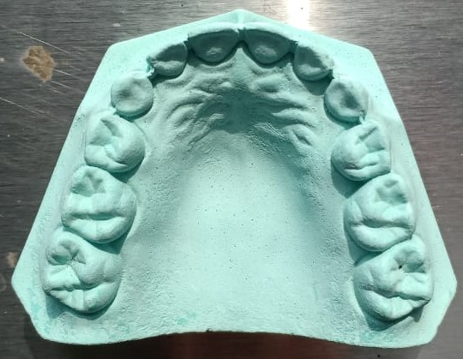
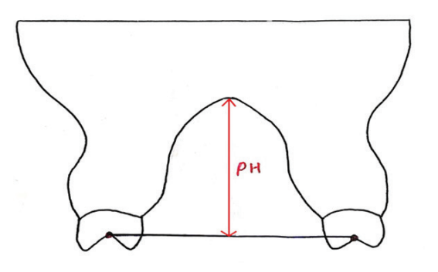
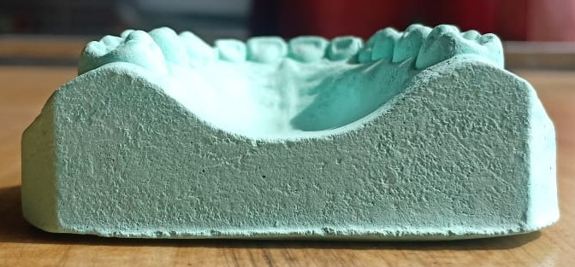
Palatal Height/ Maxillary (palatal) Depth
KORKHAUS Palatal Index (PHI)
According to Korkhaus (1939)- Palatal height is measured as a vertical line perpendicular to the midpalatal raphe runs from the surface of the palate to the level of palatal plane, measured between the reference point of the Pont’s index (Measured molar value (MMV)- Width of the arch in the molar region between the mesial pit of the maxillary right and left permanent 1st molars) for posterior arch width.
ENTER
Korkhaus palatal height
The vertical distance between depth of palate and occlusal surface at first molar region was measured using metallic scale and depth rod of digital Vernier caliper. The vertical distance between depth of first molar fissure and height of palatal cusp of first molar was subtracted from this distance to obtain the palatal height as described by Korkhaus.
Maxillary depth
Maxillary depth
Measured from a line which connects the occlusal plane up to the greatest palatal depth.
ANALYSE

Slide 24
Palatal height index/Palatal height/ Maxillary depth
Palatal height index | Patients | Average values (mm)
 |  | Korkhaus >42% = High Palate <42% = Shallow Palate Iran (5- 18 yrs) korkhaus compass digital caliper Primary: 27.53 ± 3.0 38.9 ± 5.11 Mixed : 24.48 ± 3.79 33.38 ± 6.28 Perm. : 33.00 ± 5.51 41.50 ± 6.44
RESULT PAGE

Slide 25
Kareem FA, Rauf AM, Rasheed TA, Hussain FA. Correlation of Three Dimensions of Palate with Maxillary Arch Form and Perimeter as Predictive Measures for Orthodontic and Orthognathic Surgery. Children (Basel). 2021 Jun 17;8(6):514. doi: 10.3390/children8060514. PMID: 34204436; PMCID: PMC8234026.
Palatal/ Maxillary Height/ Depth | Patient’s | Average values (mm) in class I subjects
 |  | India (adults) Perm. : 20.75 Brazil (9-12yrs), from a line which connects the occlusal plane up to the greatest palatal depth.) male female 9 years - 11.0 9.40 10 years - 11.71 9.72 11 years - 11.00 10.84 12 years - 12.20 10.87 Iran (5- 18 yrs) Palatal height at molar area: Primary dentition: the perpendicular distance from a line drawn from the distal margin of second primary molars to the palatal vault in the midline Mixed and permanent dentition: the perpendicular distance from a line drawn from the distal margin of permanent first molars to the palatal vault in the midline male female Primary: 10.90 11.51 Mixed : 13.02 11.03 Perm. : 15.91 15.24 Iraq (16-24yrs) male female Perm. : 22.09 22.75

Slide 26
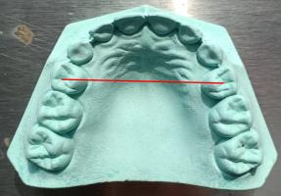
Transverse arch analysis
Pont’s and Shwarz
RESEARCH ARTICLE| OCTOBER 01 1958
A Study Of Pont's, Howes', Rees', Neff's And Bolton's Analyses On Class I Adult Dentitions*
John Stifter, B.S., D.D.S.
Angle Orthod (1958) 28 (4): 215–225.
https://doi.org/10.1043/0003-3219(1958)028<0215:ASOPHR>2.0.CO;2

Slide 27
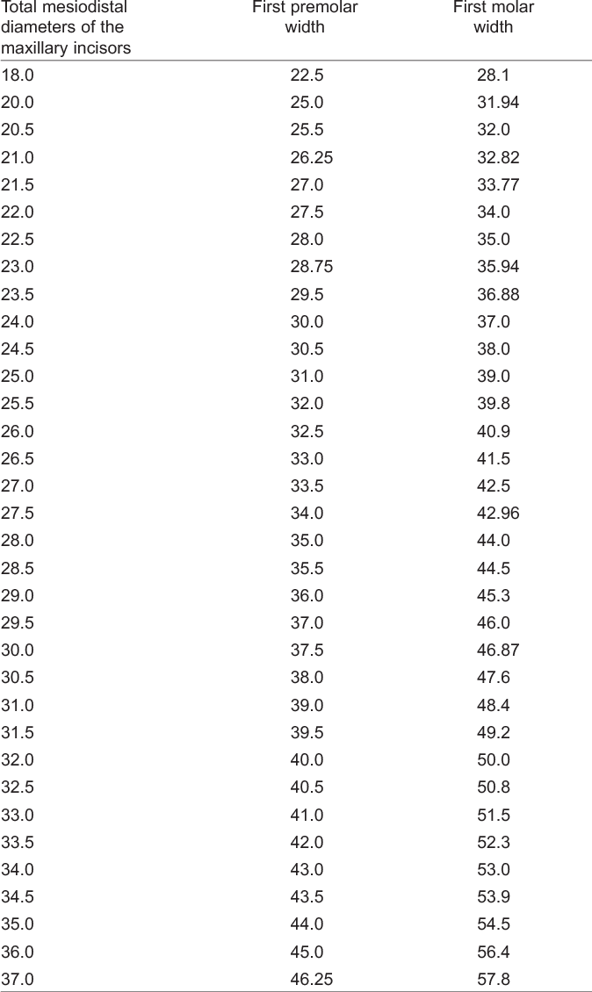
PONT’S INDEX CHART

Slide 28
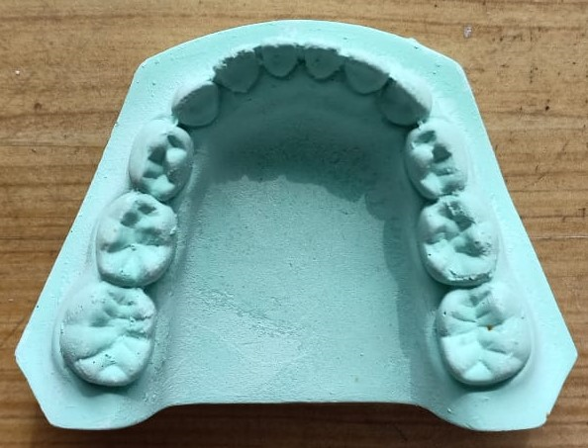
S 31
Pont’s Analysis
ENTER
Measured premolar Value (MPV)
Measured premolar Value (MPV)
Maxilla
Width of the arch in the premolar region from the distal pit of the maxillary 1stpremolar/ primary 1stmolar to the distal pit of the opposite 1stpremolar/ primary 1stmolar
Maxilla
Mandible
Width of the arch in the premolar region between the distobuccal occlusal point angle of the right and left mandibular 1stpremolars/primary 1stmolars
Mandible

Slide 29
Pont’s Analysis
ENTER
Measured molar Value (MMV)
Measured molar Value (MMV)
Maxilla
Width of the arch in the molar region between the mesial pit of the maxillary right and left permanent 1stmolars
Maxilla
Mandible
Width of the arch in the molar region between the cusp tips of middle buccal cusp of right and left mandibular permanent 1stmolars
Mandible

Slide 30
Space discrepancy, Incisor and buccal segments
Maxilla
Incisor space discrepancy
Predicted combined width of mandibular permanent cuspid and bicuspids |  |  | Buccal space discrepancy |  | Incisor space discrepancy | All total discrepancy
According to | right | left | right | left
Moyer’s (……%)
Tanaka & Johnston
Huckaba’s
Fauda’s
Bachmann’s
Trankmann’s
Regional
Buccal space discrepancy RIGHT
Buccal space discrepancy LEFT
RESULT PAGE

Slide 31
Space discrepancy, Incisor and buccal segments
Mandible
Predicted combined width of mandibular permanent cuspid and bicuspids |  |  | Buccal space discrepancy |  | Incisor space discrepancy | All total discrepancy
According to | right | left | right | left
Moyer’s (……%)
Tanaka & Johnston
Huckaba’s
Fauda’s
Bachmann’s
Trankmann’s
Regional
Buccal space discrepancy RIGHT
Buccal space discrepancy LEFT
Incisor space discrepancy
RESULT PAGE

Slide 32
S31-1
Pont’s analysis
 | Maxilla | Mandible | Inference
Measured premolar value (MPV) |  |  | If the MPV/ MMV is less than CPV/ CMV, it indicates expansion is needed
Calculated premolar value (CPV)
Discrepancy
Measured molar value (MMV)
Calculated molar value (CMV)
Discrepancy
Click here for PONT’S INDEX CHART
Result page 5

Slide 33
S48, 49, 50
Schwarz Analysis
ENTER
Measured premolar Value (MPV)
Measured premolar Value (MPV)
Maxilla
Width of the arch in the premolar region from the distal pit of the maxillary 1stpremolar/ primary 1stmolar to the distal pit of the opposite 1stpremolar/ primary 1stmolar
Maxilla
Mandible
Is maxillary first premolar erupted
(1=yes, 2=no)
Mandible
Width of the arch in the premolar region from the interproximal contact between mandibular 1st& 2ndpremolars/ primary 1st& 2ndmolars on the left to the right side
Face type (1= Euryprosopic, 2= Mesoprosopic, 3= Leptoprosopic)
Are lateral incisors peg shaped?
(1=yes, 2=no)

Slide 34
Schwarz Analysis
ENTER
Measured molar Value (MMV)
Measured molar Value (MMV)
Maxilla
Width of the arch in the molar region between the mesial pit of the maxillary right and left permanent 1stmolars
Maxilla
Mandible
Width of the arch in the molar region between the Distal Buccal Cusp tip of right and left mandibular 1st molars
Mandible

Slide 35
Schwarz analysis
 | Maxilla | Mandible | Inference
Measured premolar value (MPV) (Actual) |  |  | 1. Discrepancy <4mm: Straight wire may be adequate enough to develop the arches without the need for expansion appliances. If the Discrepancy >4mm: consider starting the case with expanders to quickly create Ideal Arch Forms and then finishing the case with Straight wire to simply align the teeth. When the Discrepancy >10mm: second expansion appliance per arch may be needed to gain all of the space required. These arches are severely constricted and treatment time is longer and more complex. The discrepancy can also help determine which arch needs expansion or if both arches need it. In many posterior crossbite cases the upper arch will be deficient and the lower arch will be close to ideal, so you may only need to expand the upper arch. Schwarz Model analysis. Technical Bulletin. Ohlendorf appliance laboratory 2. Discrepancy <4mm: No extraction, space supervision, arch development Discrepancy 5-9mm: arch development, extraction of some teeth Discrepancy >10mm: almost always require extraction of premolars or 2nd molars The Schwarz Model Analysis. The practice building bulletin. Vol IV, Issue XX.
Calculated premolar value (CPV) (Should be)
Discrepancy
Measured molar value (MMV) (Actual)
Calculated molar value (CMV) (Should be)
Discrepancy
Result page 6

Slide 36
S
Bolton’s Anterior and overall Ratio
100
Using
choose any one of the mixed dentition analysis for over all ratio
Use Huckaba’s for anterior ratio in mixed dentition.
77.2 ± 1.65
100
91.3 ± 1.91

Slide 37
S
Bolton’s Anterior and overall Ratio
100
Bolton’s anterior ratio (Huckaba’s analysis is needed in mixed dentition) |  | >77.2 ± 1.65 - mandibular excess <77.2 ± 1.65 - maxillary excess | Amount of mandibular/ maxillary excess
Bolton’s overall ratio |  | >91.3 ± 1.91- mandibular excess <91.3 ± 1.91- maxillary excess | Amount of mandibular/ maxillary excess
77.2 ± 1.65
(range 74.5 – 80.4)
100
91.3 ± 1.91
(range 87.5 – 94.8)
RESULT PAGE

Slide 38
View combined Result (Select your options)
COMPREHENSIVE TABLE FOR mixed DENTITION
Actual Combined width permanent canine, first & second premolar on right OR left | Moyer’s prediction table Percentiles |  |  |  |  |  |  |  |  | Tanaka & Johnston | Bachmann | Trackmann | Regional Formula | Huckaba’s
 |  |  |  |  |  |  |  |  |  |  |  |  |  | Right |  |  | Left
 |  |  |  |  |  |  |  |  |  |  |  |  |  | 3 | 4 | 5 | 3 | 4 | 5
 | 5 | 15 | 25 | 35 | 50 | 65 | 75 | 85 | 95
 | Predicted combined width of permanent canine, first & second premolar on right OR left |  |  |  |  |  |  |  |  |  |  |  |  | Predicted combined width of permanent canine, first & second premolar

Slide 39
COMREHENSIVE TABLE FOR MIXED DENTITION
Buccal Space discrepancy Tooth size arch length discrepancy (TSALD) | Moyer’s prediction table Percentiles |  |  |  |  |  |  |  |  | Tanaka & Johnston | Bachmann | Trackmann | Regional Formula | Huckaba’s
 |  |  |  |  |  |  |  |  |  |  |  |  |  | Right |  |  | Left
 |  |  |  |  |  |  |  |  |  |  |  |  |  | 3 | 4 | 5 | 3 | 4 | 5
 | 5 | 15 | 25 | 35 | 50 | 65 | 75 | 85 | 95
 | Predicted combined width of permanent canine, first & second premolar on right OR left |  |  |  |  |  |  |  |  |  |  |  |  | Predicted combined width of permanent canine, first & second premolar
RESULT PAGE

Slide 40
Analyze
ANALYZE
Incisor space discrepancy
and/or
Leeway space of nance
using
Moyer’s probability chart
Tanaka & Johnston
Huckaba’s radiographic method
Fouda’s method
Bachmann method
Trankmann method
Regional regression equations (India)
Bhopal (MP)
Patiala (Panjab)
Patna (Bihar)
New window should open to enter percentile and sex of patient (S-)
new inclusions
New window shd open to enter radiographic and actual width of teeth (S-)

Slide 41
CEPHALOMETRIC ANALYSIS IN MIXED DENTITION
Tweed’s analysis
Total space analysis ( Levern Merrifield analysis)

Slide 42
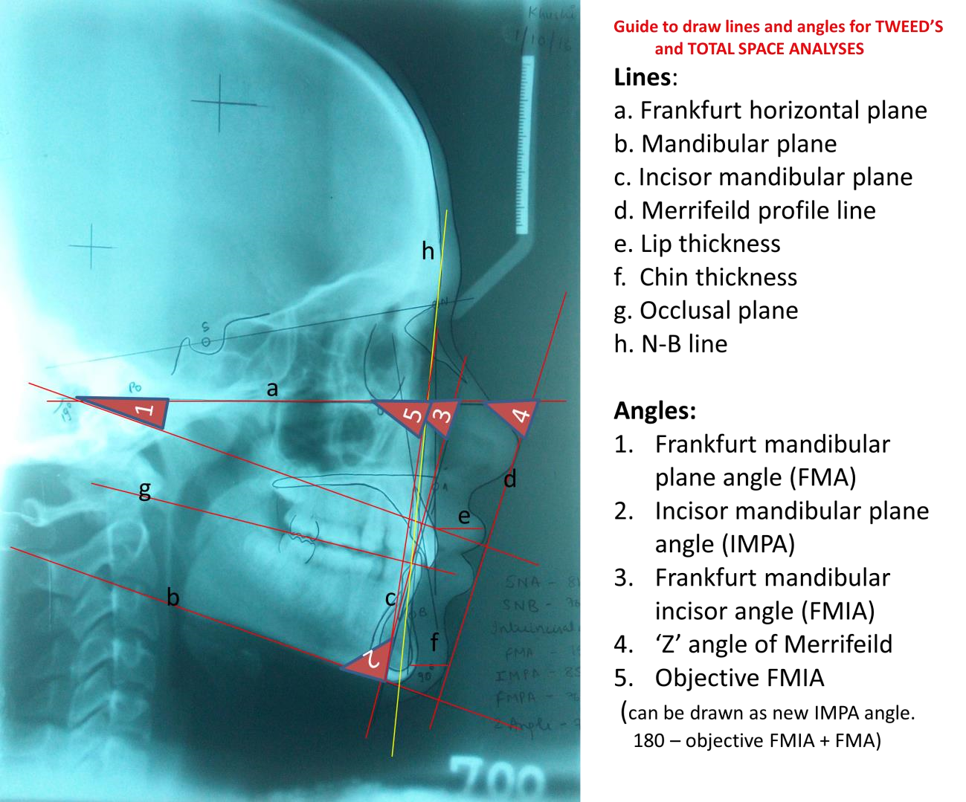
Lines and angles needed for Tweed’s and Total space analysis
-measured from the vermilion border of the lip to the greatest curvature of the labial surface of the central incisor.
- measured from the soft tissue chin to the N-B line
Line drawn parallel to mandibular plane (b)
Jack G Dale, Hali C Dale. Interceptive Guidance of Occlusion with Emphasis on Diagnosis, chapter 13 in Orthodontics: Current Principles and Technique. Fifth edition; Editor Xubair Ahmed

Slide 43
Actual Value Objective value
Frankfort mandibular plane angle [FMA]:
2. Incisor mandibular plane angle [IMPA] :
3. Frankfort mandibular incisor angle [FMIA]:
To draw objective FMIA on cephalogram,
calculate objective IMPA= 180 – (FMA+ objective FMIA).
Then draw corrected mandibular incisor position
Tweed’s analysis:
ENTER
FMIA
Actual Objective
Cephalometric correction (D):
Distance between actual and objective line on the occlusal plane:
Objective of FMIA after correction (Tweed foundation):
If the FMA is, FMIA should be
21° - 29° 68°
30° - >30° 65°
20° - <20° IMPA should not exceed 92°

Slide 44
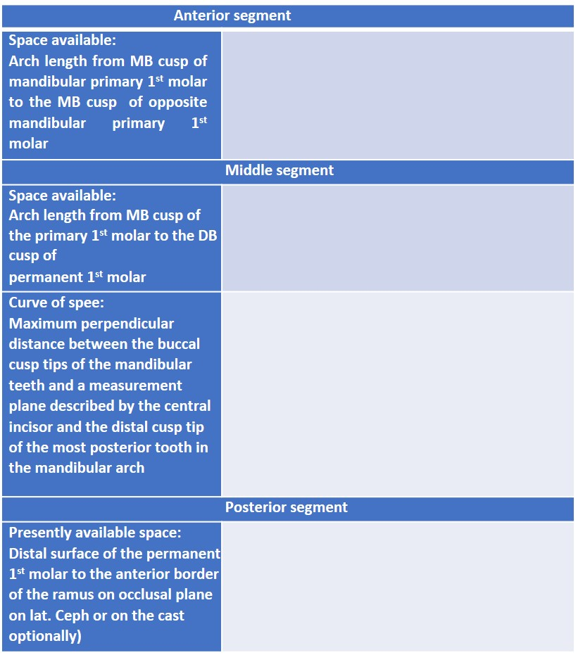
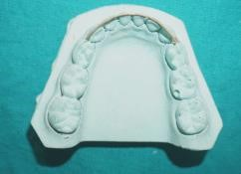
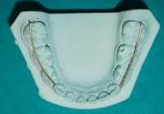
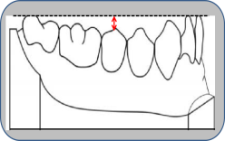
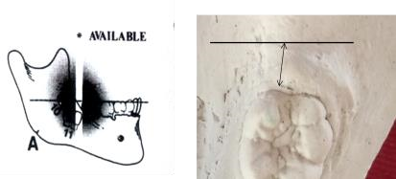
TOTAL SPACE ANALYSIS (Cephalometric)
Space available (Mandibular arch only)
ENTER
Anterior segment
Middle segment
Space available- Right Left
Curve of spee- Right Left
Posterior segment
Right Left
Width of mandibular permanent 1st molar
Actual from cast
Right Left
Apparent from radiograph
Right Left
Width of mandibular permanent 2nd molar
Apparent from radiograph
Right Left
Width of mandibular permanent 3rd molar
Apparent from radiograph (default value=10mm)
Right Left
Lip thickness Chin thickness
Patient’s gender (type 1 for male & 2 for female)
Patient’s present age
Jack G Dale, Hali C Dale. Interceptive Guidance of Occlusion with Emphasis on Diagnosis, chapter 13 in Orthodontics: Current Principles and Technique. Fifth edition; Editor Xubair Ahmed

Slide 45
REFERENCES
1. Stifter J. A Study Of Pont's, Howes', Rees', Neff's And Bolton's Analyses On Class I Adult Dentitions. Angle Orthod (1958) 28 (4): 215–225.
https://doi.org/10.1043/0003-3219(1958)028<0215:ASOPHR>2.0.CO;2
2. Adhikari D, Shrestha RM, Chand D, Acharya A. Comparison of Palatal Morphology in Angle’s Class I and Class II Division 1 Malocclusions . J Nepal Dent Association 2020; Vol. 20 No. 1 (30): 28-31.
3. Louly F, Nouer PR, Janson G, Pinzan A. Dental arch dimensions in the mixed dentition: a study of Brazilian children from 9 to 12 years of age. J Appl Oral Sci. 2011 Apr;19(2):169-174.
doi: 10.1590/s1678-77572011000200014. PMID: 21552719; PMCID: PMC4243756.
4. Dale JG, Hali C Dale HC. Interceptive Guidance of Occlusion with Emphasis on Diagnosis, chapter 13 in Orthodontics: Current Principles and Technique. Fifth edition; Editor Xubair Ahmed
Kareem, F.A.; Rauf, A.M.; Rasheed, T.A.; Hussain, F.A. Correlation of Three Dimensions of Palate with Maxillary Arch Form and Perimeter as Predictive Measures for Orthodontic and Orthognathic Surgery. Children 2021, 8, 514. https:// doi.org/10.3390/children8060514
Nainan O, Jayan B, Ghosh S, Mitra R. Dental Arch Morphology as a Predictor of Sleep Disordered Breathing. Sleep and Hypnosis. 2016; 19(2):
DOI:10.5350/Sleep.Hypn.2016.18.0117
Jyoti D, Mukharjee C (guide). Comparative evaluation and applicability of four different regression equation- based mixed dentition analysis in Patna, Bihar population [Unpublished Master’s thesis 2021]. Magadh University, Bodh Gaya (Bihar, India).
Ahluwalia P, Jodhka S, Thomas AB. Prediction of Mesio-distal width of Canines and Premolars in a sample of North Indian population. Indian J Dent Advancements 2011; 3(3): 568-571.
Agrawal N, Shashikiran ND, Singla S, Kulkarni VK, Ravi KS. Moyer’s mixed dentition predictable values correlation among hindu children in Bhopal city. Annals and Essences of Dentistry 2013; 5(3): 6-10.

